Slide 1

Xamarin Oleksandr Krakovetskyi CEO, DevRain Solutions @msugvnua, alex.krakovetskiy@devrain.com

Slide 2
About
CEO of DevRain Solutions – software development.
Microsoft Regional Director.
Microsoft Windows Phone Most Valuable Professional (Windows Platform Development).
Best Professional in Software Architecture (Ukrainian IT Award).
Ph.D. in Computer Science.
Speaker and blogger.

Slide 3
Agenda
Platform Convergence Journey and UWP
Xamarin Growth
Microsoft + Xamarin = Complete Mobile Ecosystem
What’s new in Xamarin 2016
Q&A

Slide 4
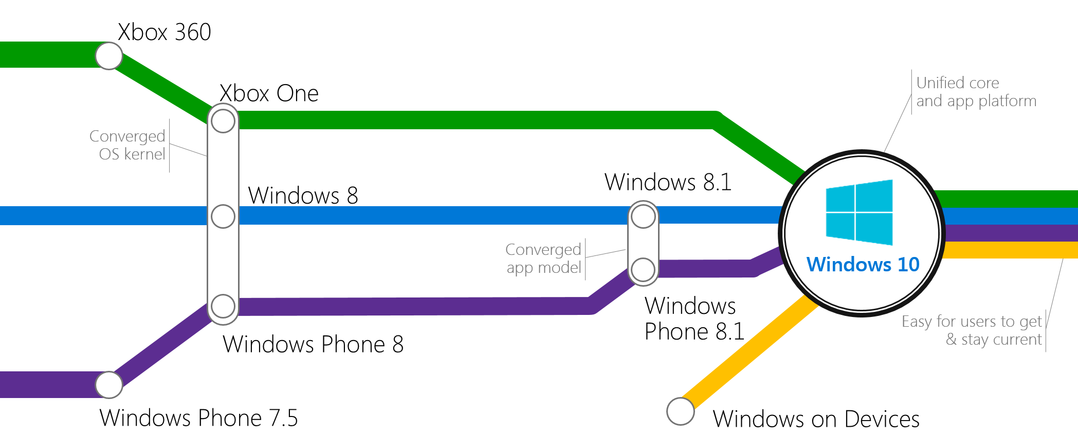
Platform Convergence Journey

Slide 5

Universal Windows Platform
Windows Platform
Web Platform
Universal Windows 8 Apps (C++/C#/JS)
Microsoft Edge HTML Engine
Universal Windows 10 Apps (C++/C#/JS)
Surface Hub
Desktop
Cordova Tooling (HTML/JS)
Project Centennial (Classic Apps)
Hosted Web Apps (HTML/JS)
Universal Windows Platform
IoT
Xbox
Middleware Platforms
Other Mobile Platforms
Middleware Partners (e.g., Xamarin)
Holographic
Mobile
Project Astoria (Java/C++)
Game Engine Partners (e.g., Unity)
Project Islandwood (Objective C/C++)

Slide 6
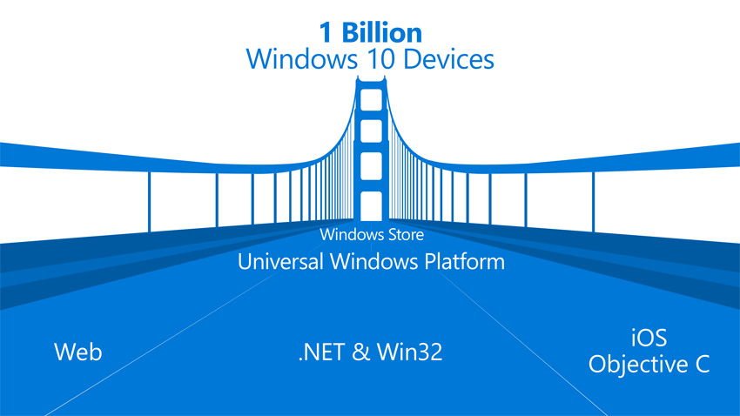
Windows Bridges
Desktop Bridge (Project Centennial)
Hosted Web Apps (”Project Westminster”)
Mobilize.Net’s Silverlight Bridge
Windows Bridge for iOS (“Project Islandwood”)
Windows Bridge for Android (”Project Astoria”)
https://developer.microsoft.com/en-us/windows/bridges

Slide 7
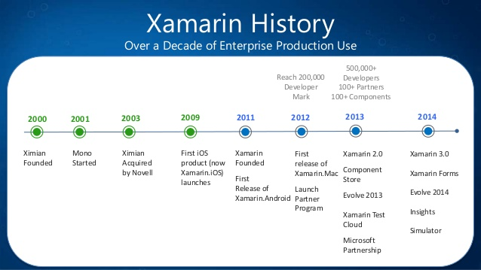
Xamarin History
Microsoft and Xamarin Expand Global Partnership (November 12, 2014)
Microsoft Agrees to Acquire Xamarin (February 24, 2016)

Slide 8
Anything you can do in Objective-C, Swift, or Java can be done in C# and Visual Studio with Xamarin.

Slide 9
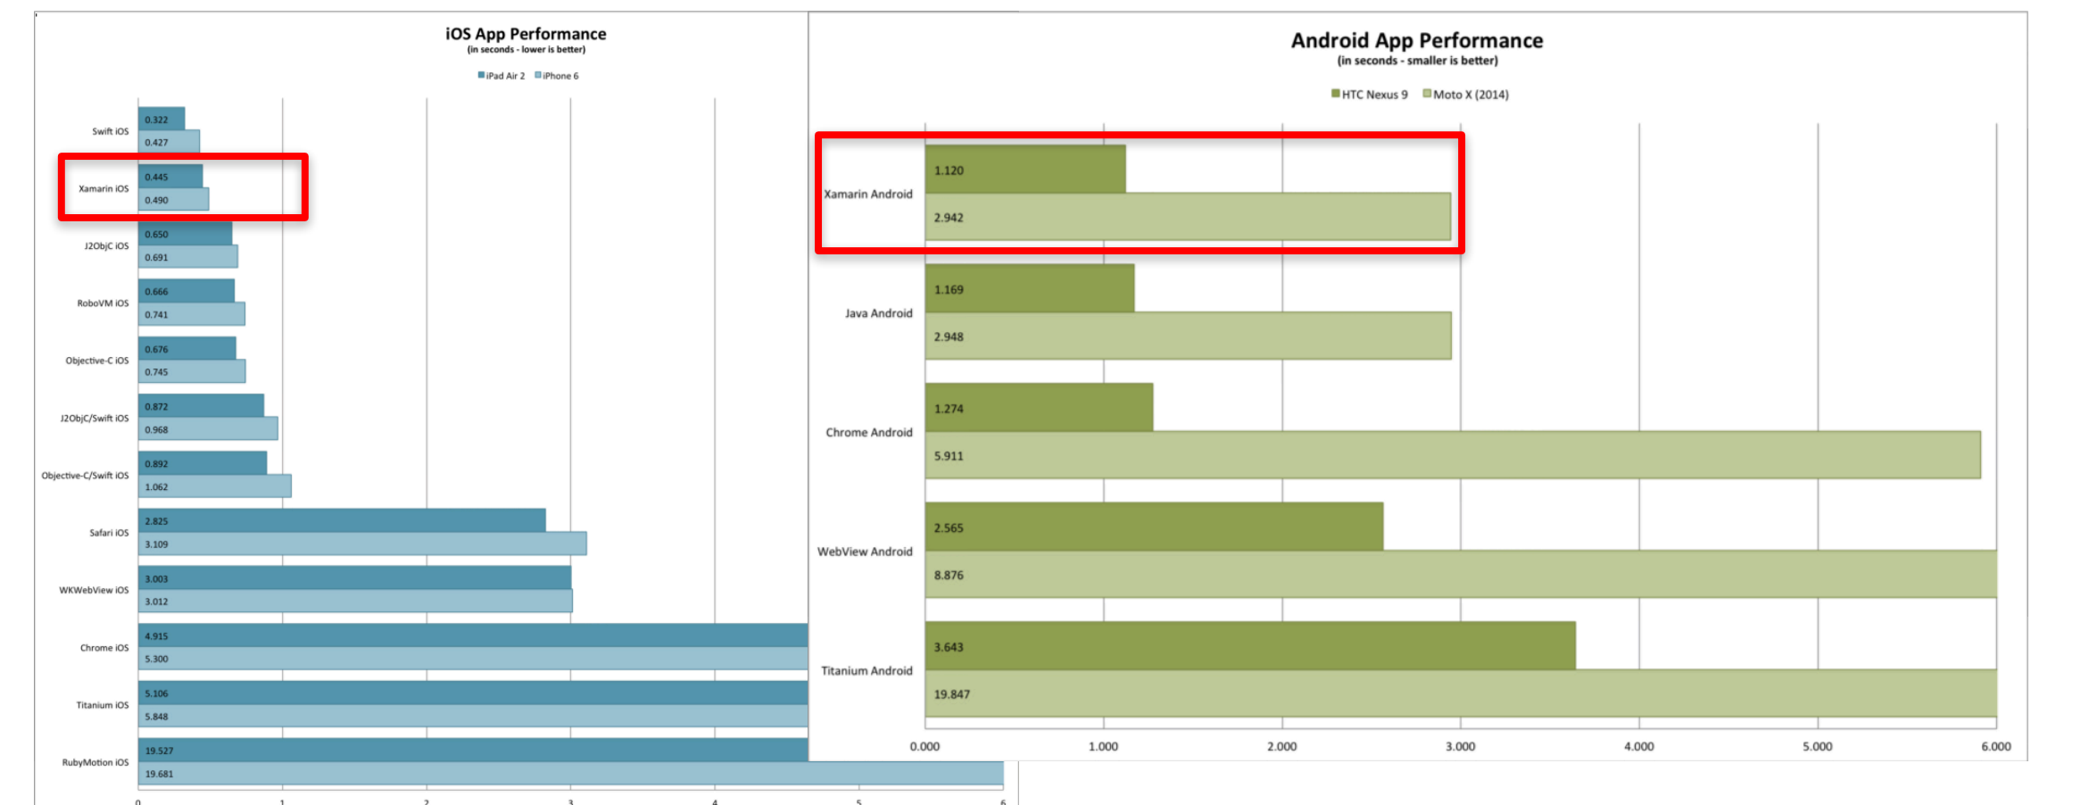
Performance

Slide 10
Drawbacks
Price. It’s not cheap.
Minor bugs & updates issues.
Applications binaries size is bigger.
Mac machine is required.
Harder to find Xamarin developers.
Xamarin.Forms are not suitable for all project types.
Not the best choice for rich UI apps with poor business logic.
Small community comparing to iOS/Android/.NET but it’s growing.
Suitable only for new apps.
Customers are afraid of cross-platform tools.

Slide 11
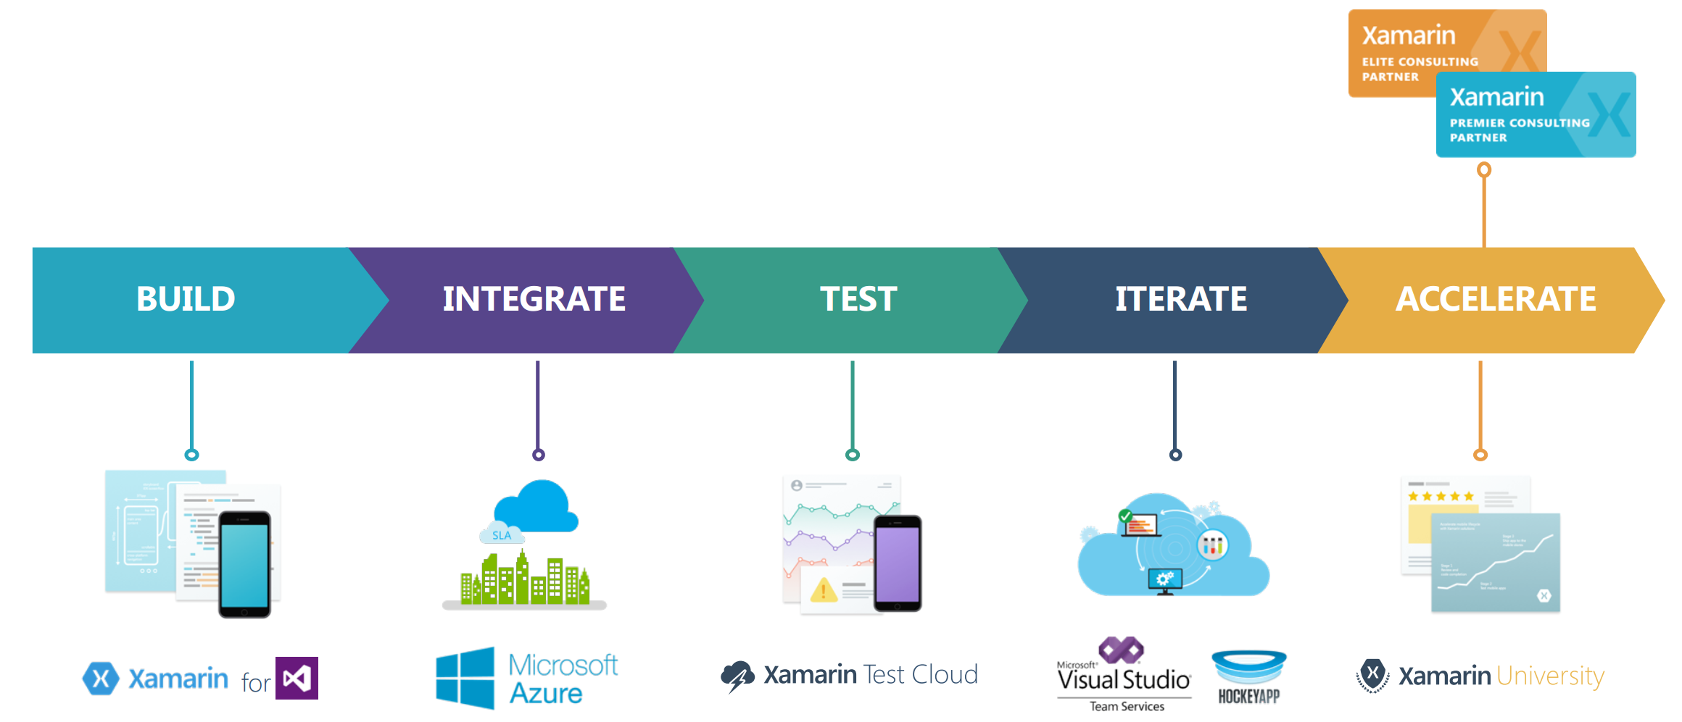
Complete Mobile Ecosystem

Slide 12
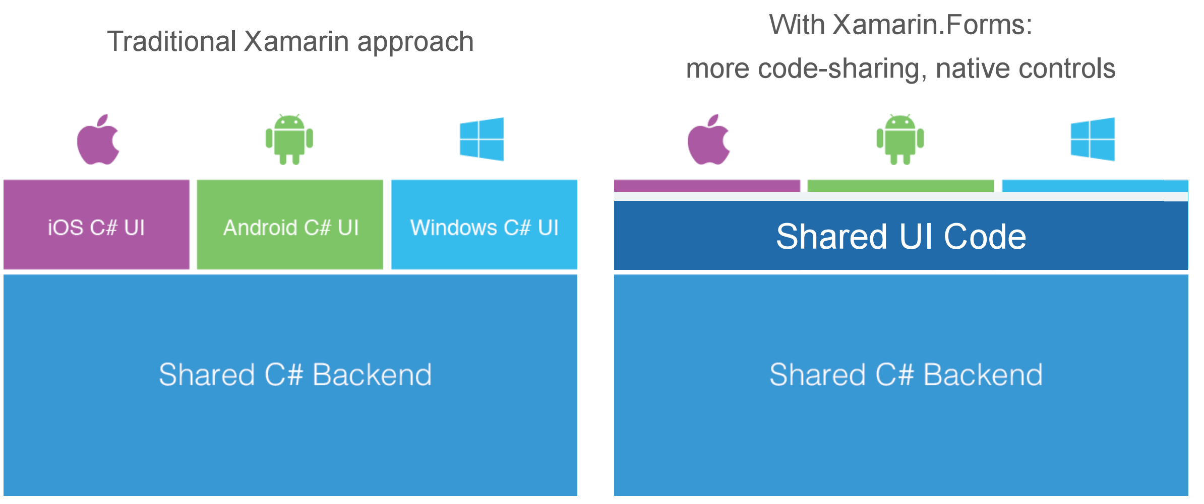
Code Sharing Architectural Approaches

Slide 13
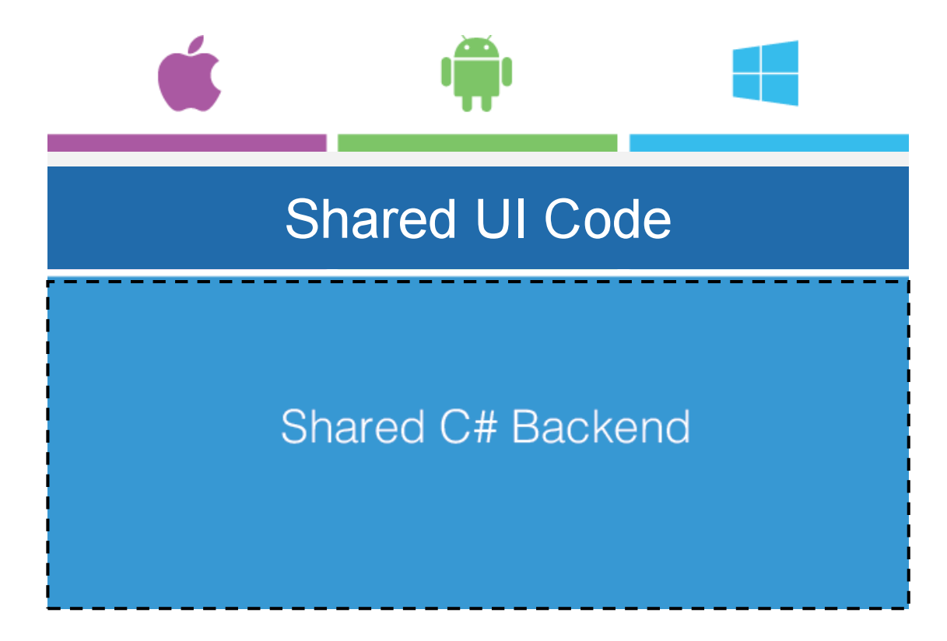
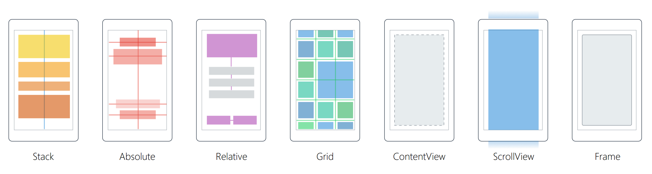
Xamarin.Forms
40+ Pages, Layouts, and Controls
Build from code behind or XAML
Two-way Data Binding
Navigation
Animation API
Dependency Service
Messaging Center

Slide 14




Making Apps Great
How can I use my app offline?
How can users sign in to my app securely?
How do I send push notifications to users?
How do I make my sales team productive ‘on the go’?
How do I make my sales team productive ‘on the go’?
How can integrate voice search be integrated into my app?
How to I manage my apps on end user devices?

Slide 15
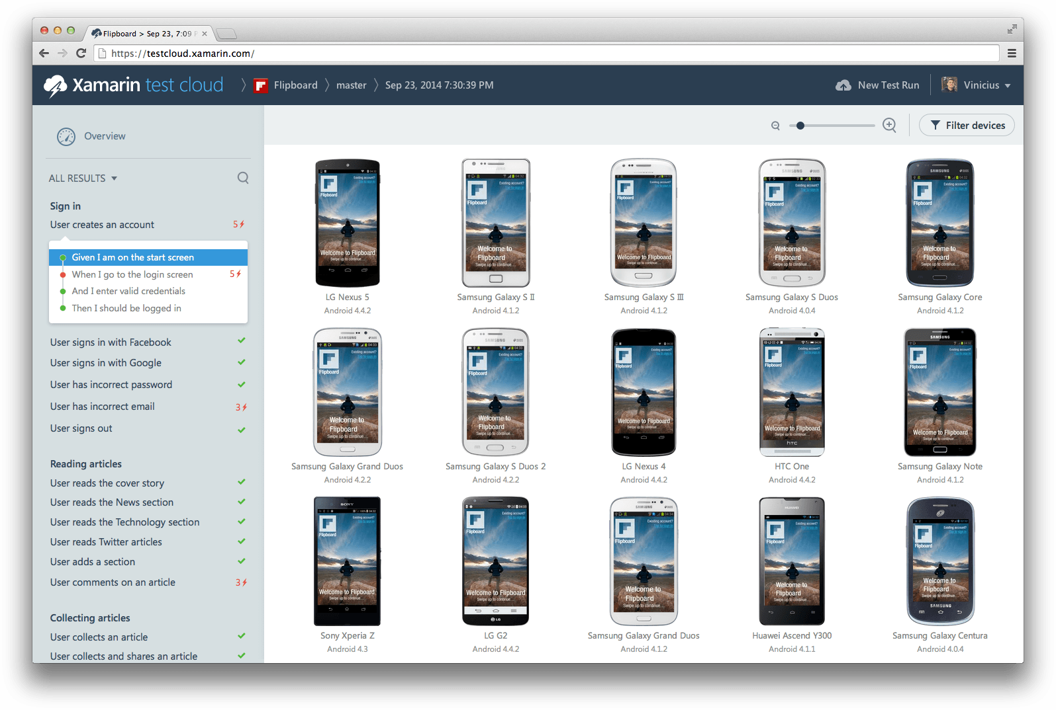
Xamarin Test Cloud: Testing on Real Devices

Slide 16



Continuously Product Improvements
Distribute app to beta users
Monitor your app’s health
Understand your users
Measure adoption and usage
Quickly resolve app crashes
Continuous Integration & Delivery

Slide 17
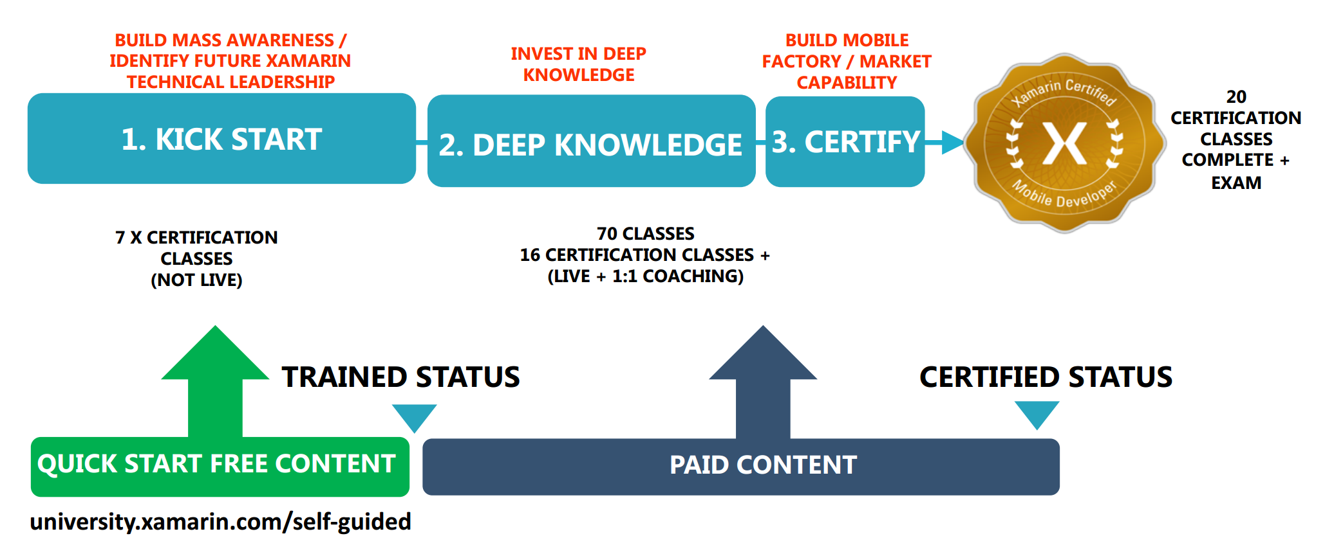
Xamarin University

Slide 18
Xamarin in 2016

Slide 19
Visual Studio Mobile Center (Preview)
Provides Mobile Center Xamarin SDK for Xamarin.iOS, Xamarin.Android, Xamarin.Forms (iOS and Android), supports apps developed on Xamarin, Java, Objective-C, Swift и React Native.
using Microsoft.Azure.Mobile;
using Microsoft.Azure.Mobile.Analytics;
using Microsoft.Azure.Mobile.Crashes;
MobileCenter.Start(typeof(Analytics), typeof(Crashes));
https://www.visualstudio.com/vs/mobile-center/

Slide 20
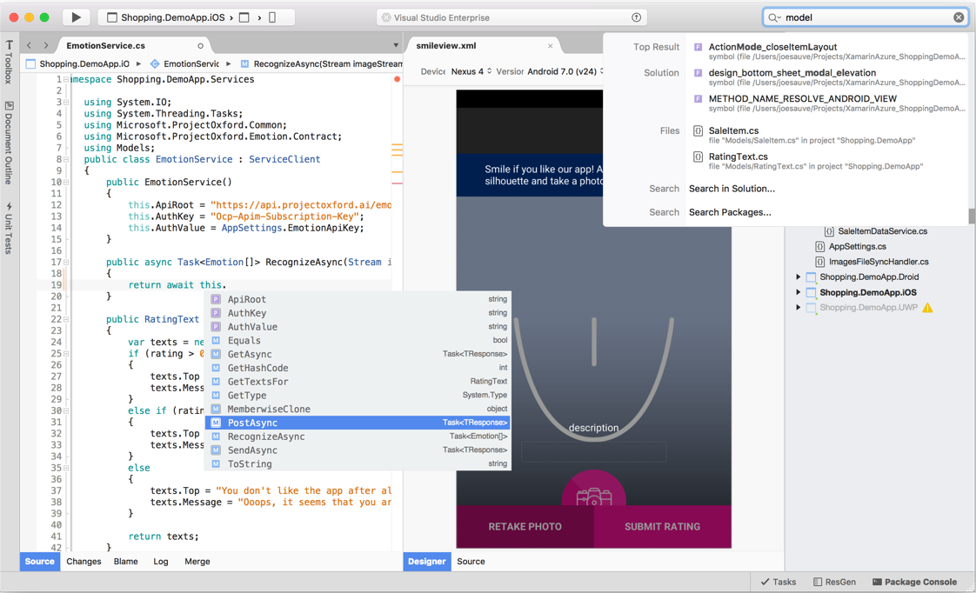
Visual Studio for Mac (Preview)
Build inative iOS and Android apps on C# and F# with Xamarin, Azure services and ASP.NET Core.
https://www.visualstudio.com/vs/visual-studio-mac/

Slide 21
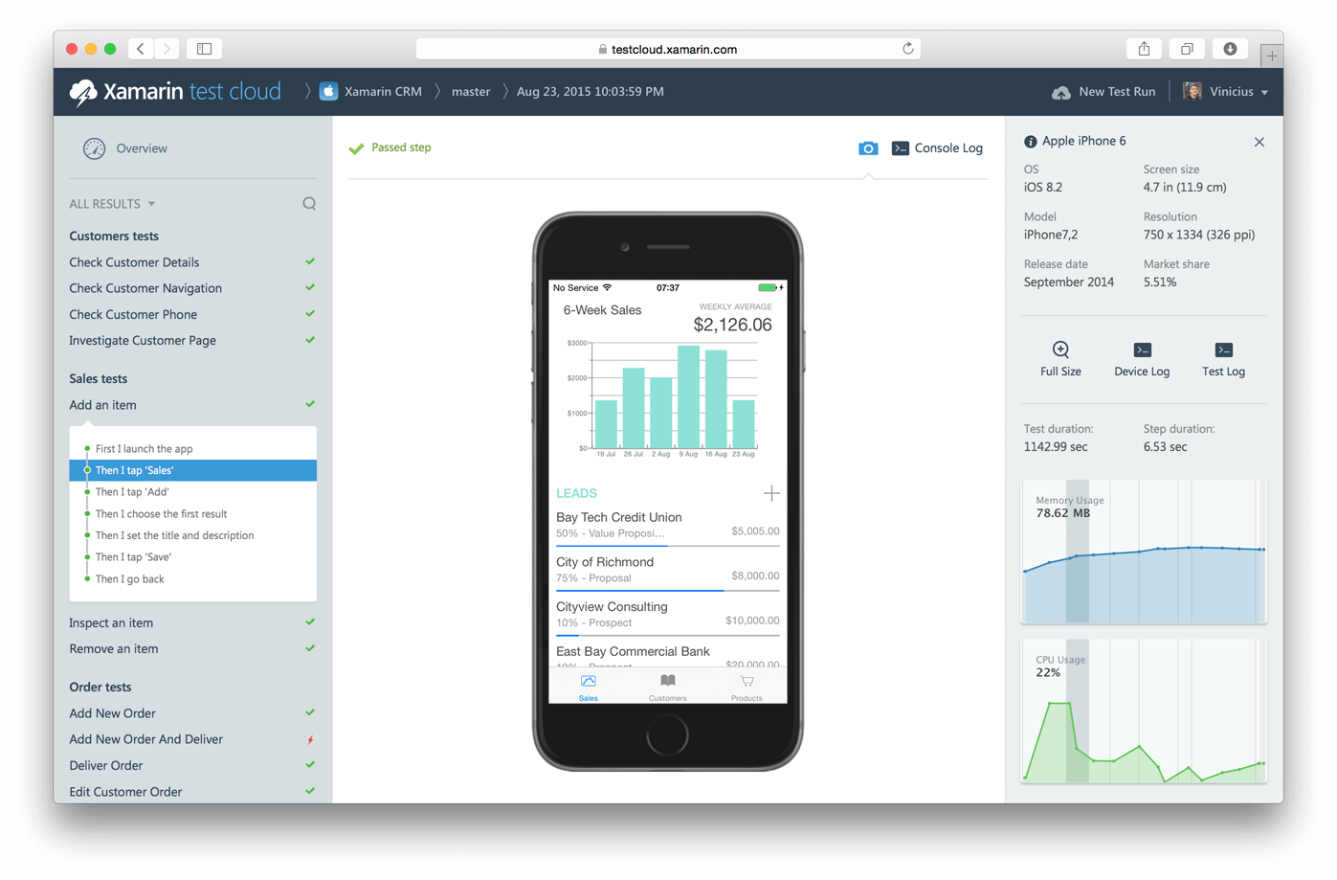

Appium in Xamarin Test Cloud
Ability for Java developers to test apps on real devices with 400+ configurations.

Slide 22
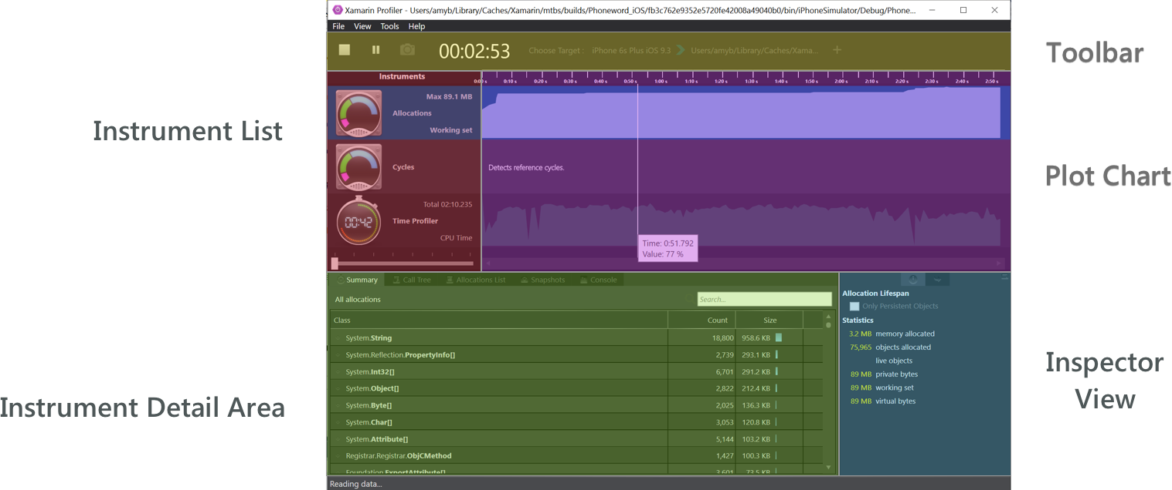
Xamarin Profiler
https://developer.xamarin.com/guides/cross-platform/profiler/

Slide 23
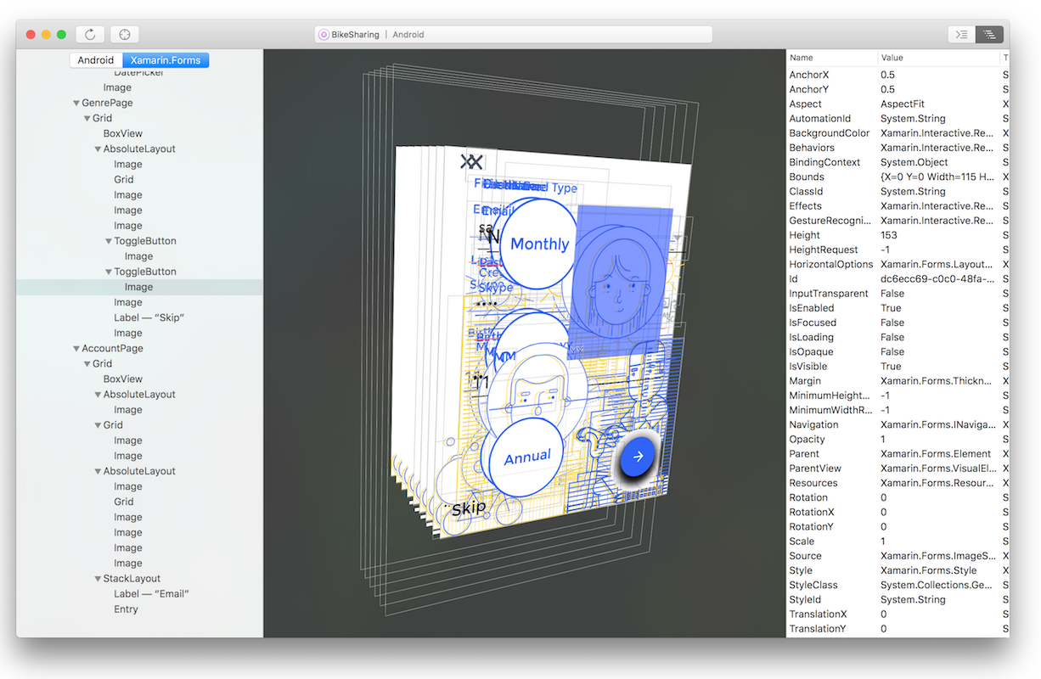
Xamarin Inspector
The Inspector integrates with the app debugging workflow of your IDE, serving as a debugging or diagnostics aid when inspecting your running app.
https://developer.xamarin.com/guides/cross-platform/inspector/

Slide 24
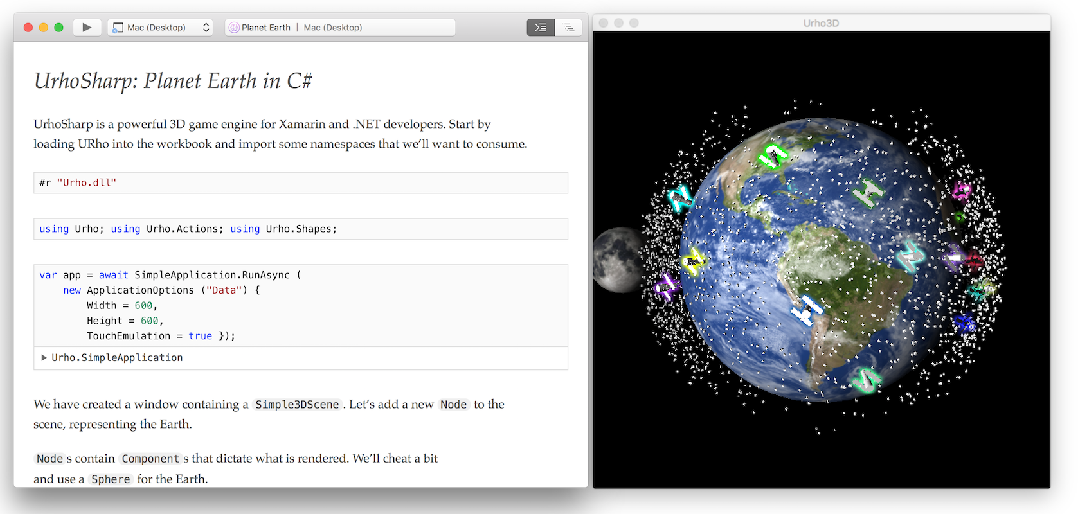
Xamarin Workbooks
A blend of documentation and code that is perfect for experimentation, learning, and creating guides and teaching aids.
https://developer.xamarin.com/guides/cross-platform/workbooks/

Slide 25
Q&A
Alex.Krakovetskiy@devrain.com
@msugvnua

